Slide 1

Travel Chatbot
-Parjita Munshi

Slide 2

Motivation
build a chatbot for a travel agent company
front-end user interface client and a backend ChatGPT-based server
build a web-based interface to receive travel related questions from users
One side some questions can be answered by the direct use of ChatGPT. E.X the distance or flight time between two cities
On the other hand, your Python backend must maintain a travel agent specific database costs, etc. for the question like the types and costs of packages varies from travel agent to travel agent

Slide 3

Approach
Frontend – Create React App
The user interface is designed with CSS on the front end.
Backend – Flask
The user enters a natural language query; chatgpt then converts it into a SQL query, which is then executed on the travale database if there is any relevant logic, such as a word that is related to any schemas.
If there is no word match, the chatgpt will provide the response.

Slide 4

Database
travel_databse.db
Tables:
Holiday packages,
Flights,
Locations,
Attractions,
Accommodations,
Package Attractions

Slide 5
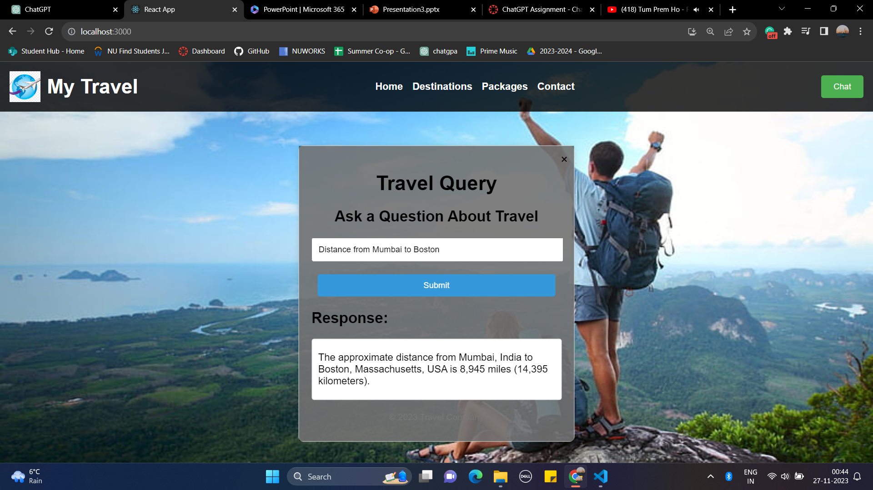
GPT Generate Response 1
Asking Question Distance from Mumbai to Boston

Slide 6

GPT Generate Response 2
Flight timing from Boston to Newyork

Slide 7
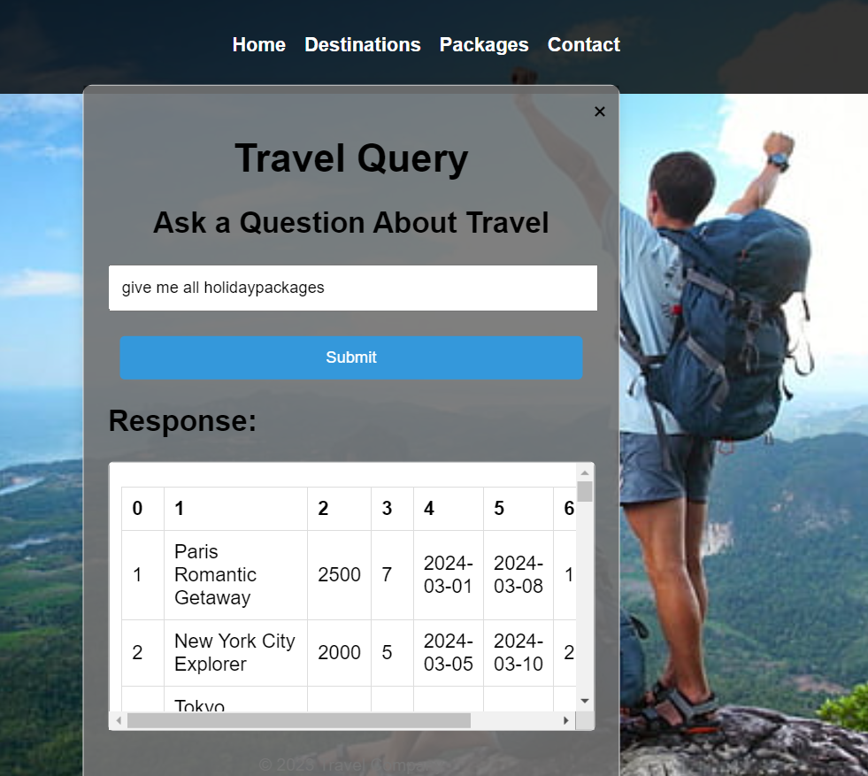
Database Related Query 1
Give me all holidaypackages

Slide 8

Database Related Query 2
compare all flights with price

Slide 9

Thank You

